Slide 1
Learning Rules

Slide 2



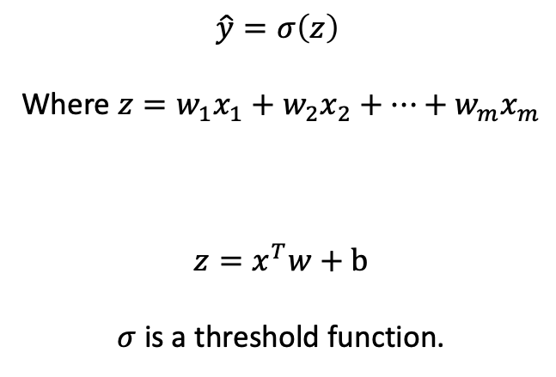




Perceptron
$$\hat{y}=σ\left(z\right)$$
Where $z=w_{1}x_{1}+w_{2}x_{2}+…+w_{m}x_{m}$
$$z=x^{T}w+b$$
$σ$ is a threshold function.
b
$$x_{1}$$
$$w_{1}$$
$$w_{2}$$
$$x_{2}$$
Σ |σ
$$\hat{y}$$
.
.
$$w_{m}$$
$$x_{m}$$

Slide 3
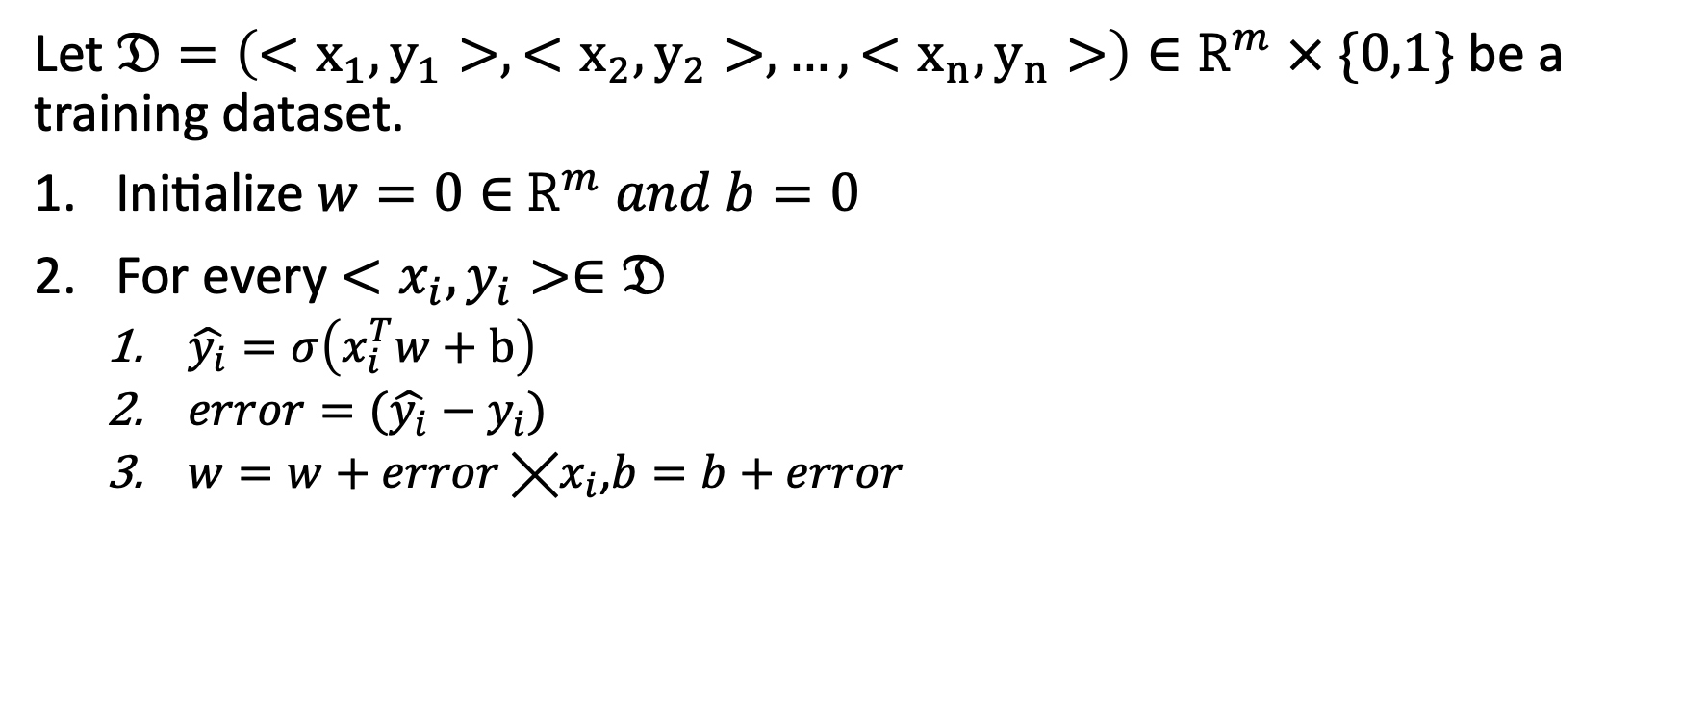
Perceptron Learning Rule
Let $𝔇=\left(<x_{1},y_{1}>,<x_{2},y_{2}>,…,<x_{n},y_{n}>\right)∈R^{m} × \{0,1\}$ be a training dataset.
Initialize $w=0∈$ $R^{m} and b=0$
For every $<x_{i},y_{i}>∈𝔇$
$\hat{y_{i}}=σ\left(x_{i}^{T}w+b\right)$
$error=(\hat{y_{i}}−y_{i})$
$w=w+error ╳x_{i}$,$b=b+error$

Slide 4
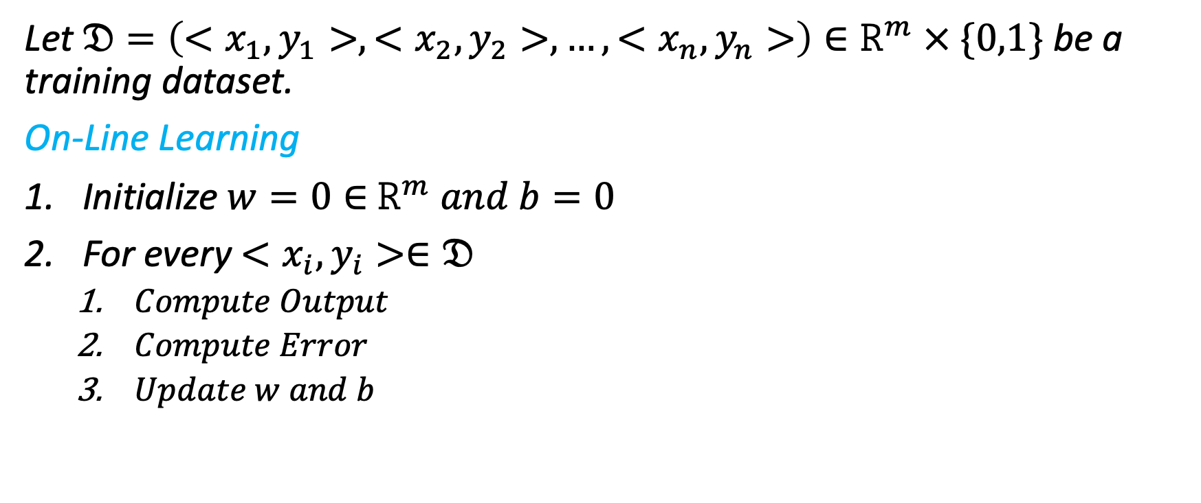
General Learning Rule
Let $𝔇=\left(<x_{1},y_{1}>,<x_{2},y_{2}>,…,<x_{n},y_{n}>\right)∈R^{m} × \{0,1\}$ be a training dataset.
On-Line Learning
Initialize $w=0∈$ $R^{m} and b=0$
For every $<x_{i},y_{i}>∈𝔇$
$Compute Output$
$Compute Error$
$Update w and b$

Slide 5
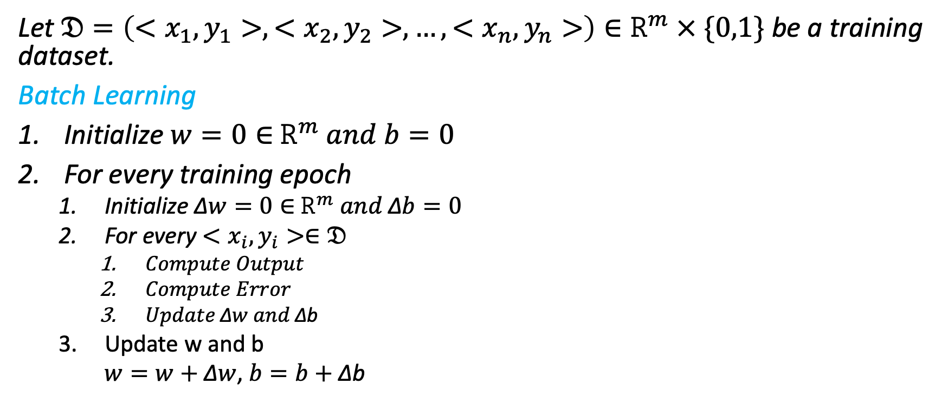
General Learning Rule
Let $𝔇=\left(<x_{1},y_{1}>,<x_{2},y_{2}>,…,<x_{n},y_{n}>\right)∈R^{m} × \{0,1\}$ be a training dataset.
Batch Learning
Initialize $w=0∈$ $R^{m} and b=0$
For every training epoch
Initialize ∆$w=0∈$ $R^{m} and \text{∆}b=0$
For every $<x_{i},y_{i}>∈𝔇$
$Compute Output$
$Compute Error$
$Update \text{∆}w and \text{∆}\text{b}$
Update w and b
$w=w+\text{∆}w$,$b=b+\text{∆}\text{b}$

Slide 6
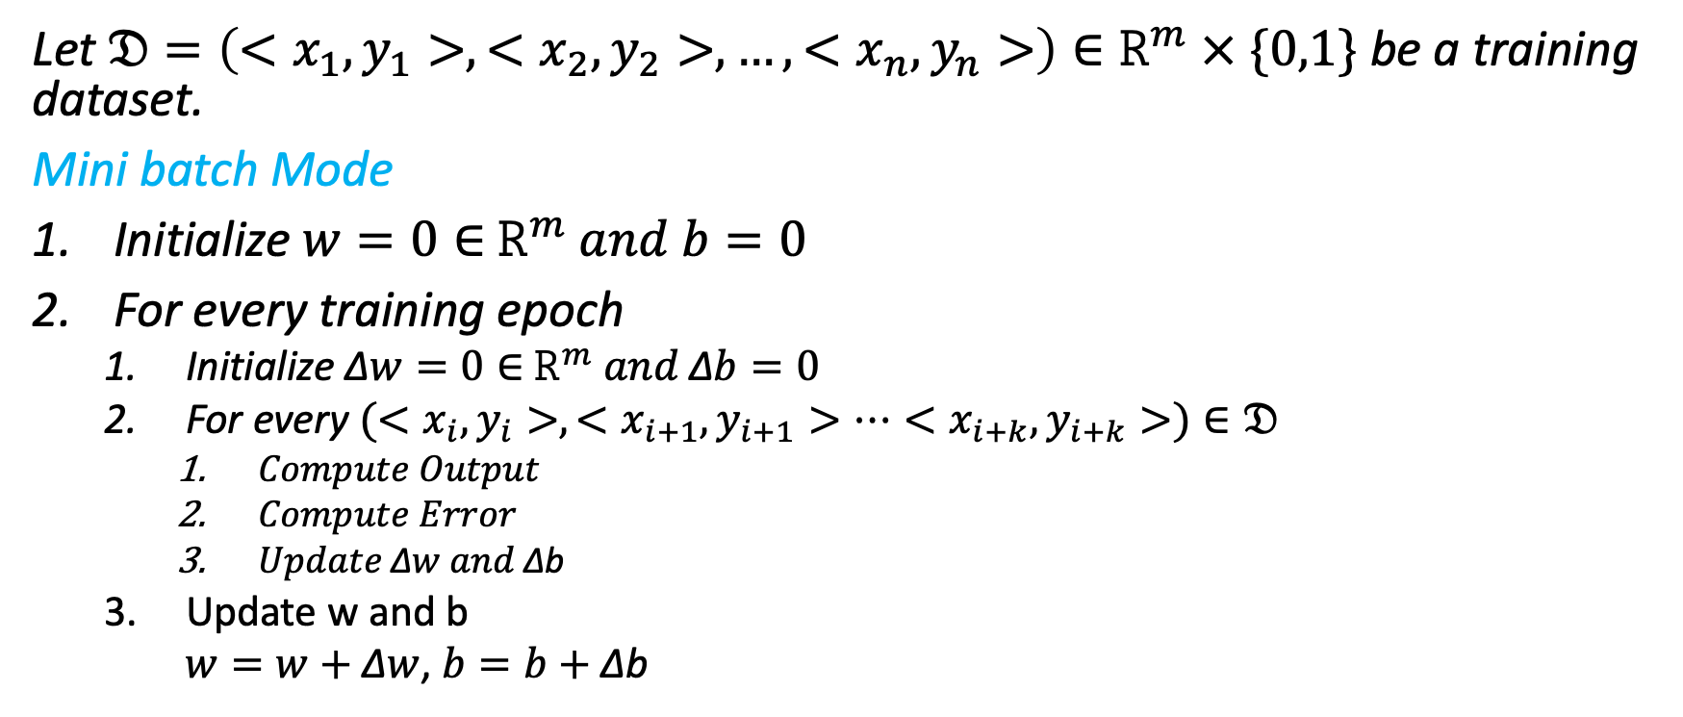
General Learning Rule
Let $𝔇=\left(<x_{1},y_{1}>,<x_{2},y_{2}>,…,<x_{n},y_{n}>\right)∈R^{m} × \{0,1\}$ be a training dataset.
Mini batch Mode
Initialize $w=0∈$ $R^{m} and b=0$
For every training epoch
Initialize ∆$w=0∈$ $R^{m} and \text{∆}b=0$
For every $(<x_{i},y_{i}>,<x_{i+1},y_{i+1}>…<x_{i+k},y_{i+k}>)∈𝔇$
$Compute Output$
$Compute Error$
$Update \text{∆}w and \text{∆}\text{b}$
Update w and b
$w=w+\text{∆}w$,$b=b+\text{∆}\text{b}$

Slide 7
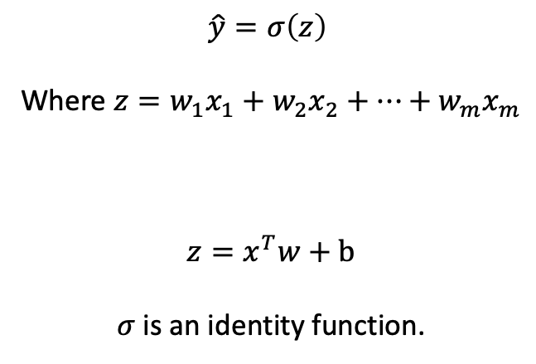
Linear Regression
$$\hat{y}=σ\left(z\right)$$
Where $z=w_{1}x_{1}+w_{2}x_{2}+…+w_{m}x_{m}$
$$z=x^{T}w+b$$
$σ$ is an identity function.
b
$$x_{1}$$
$$w_{1}$$
$$w_{2}$$
$$x_{2}$$
Σ |σ
$$\hat{y}$$
.
.
$$w_{m}$$
$$x_{m}$$

Slide 8
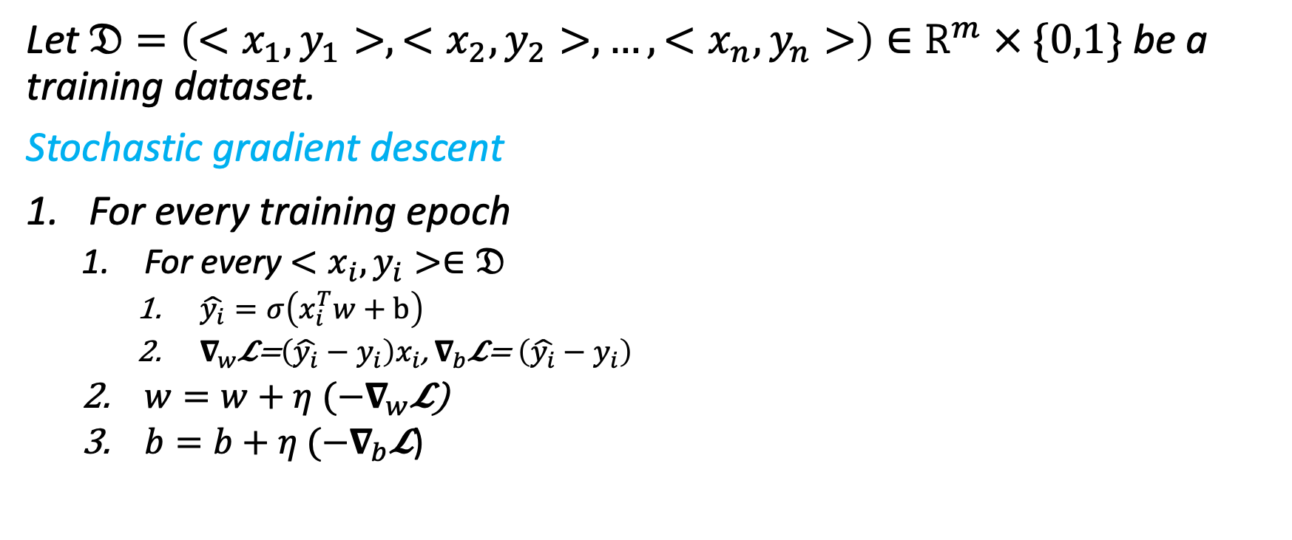
General Learning Rule
Let $𝔇=\left(<x_{1},y_{1}>,<x_{2},y_{2}>,…,<x_{n},y_{n}>\right)∈R^{m} × \{0,1\}$ be a training dataset.
Stochastic gradient descent
For every training epoch
For every $<x_{i},y_{i}>∈𝔇$
$\hat{y_{i}}=σ\left(x_{i}^{T}w+b\right)$
$∇_{w}$𝓛=$\left(\hat{y_{i}}−y_{i}\right)x_{i}$, $∇_{b}$𝓛= $\left(\hat{y_{i}}−y_{i}\right)$
$w=w+{η (−∇}_{w}\text{𝓛}\text{)}$
$b=b+{η (−∇}_{b}\text{𝓛}$)

Slide 9
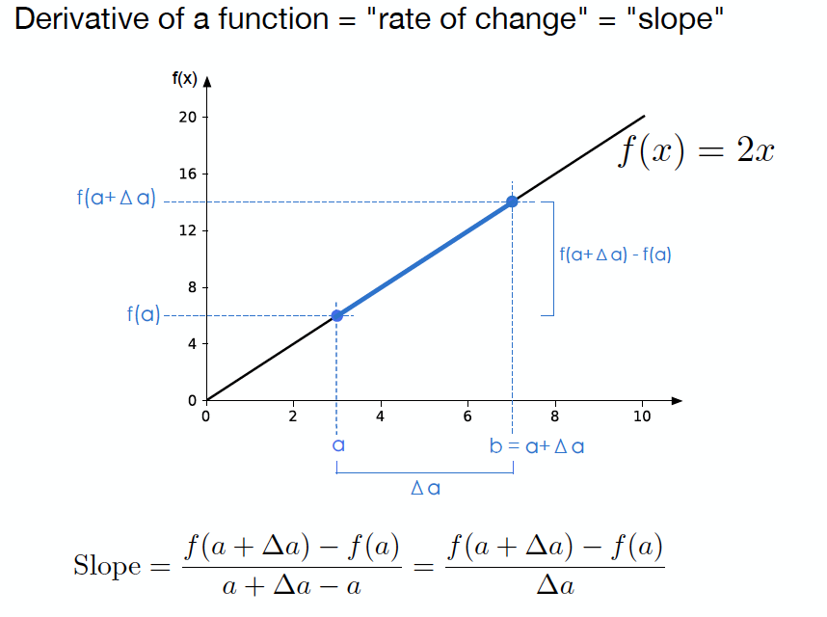
Differential Calculus (Derivatives)

Slide 10
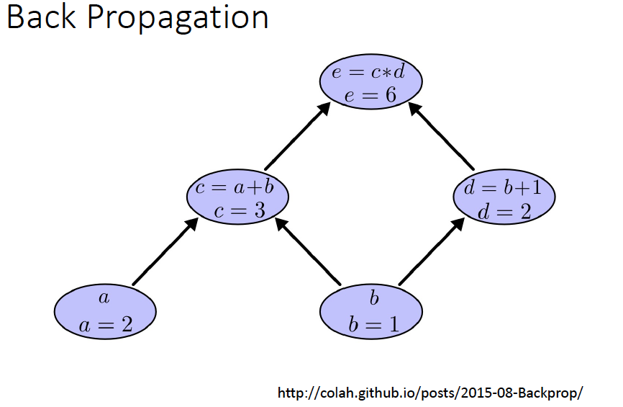

Slide 11
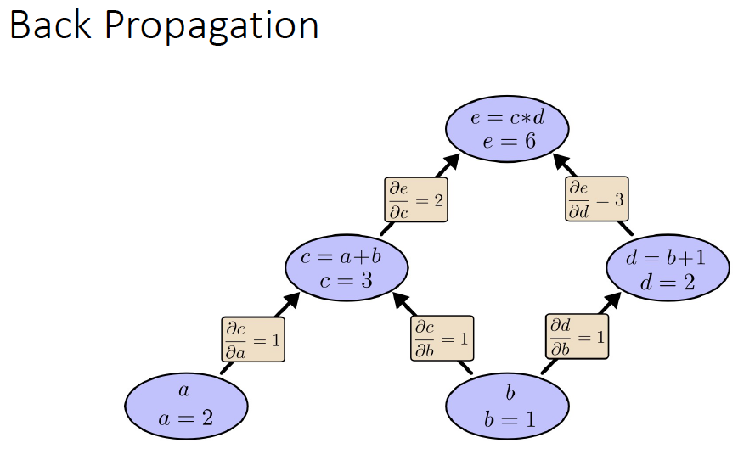

Slide 12
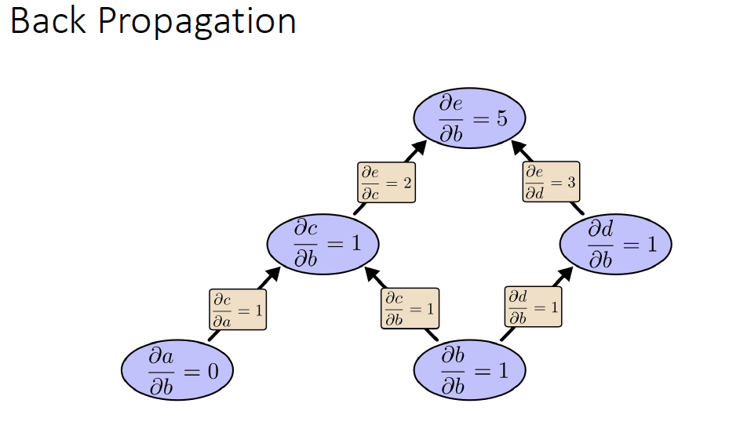

Slide 13
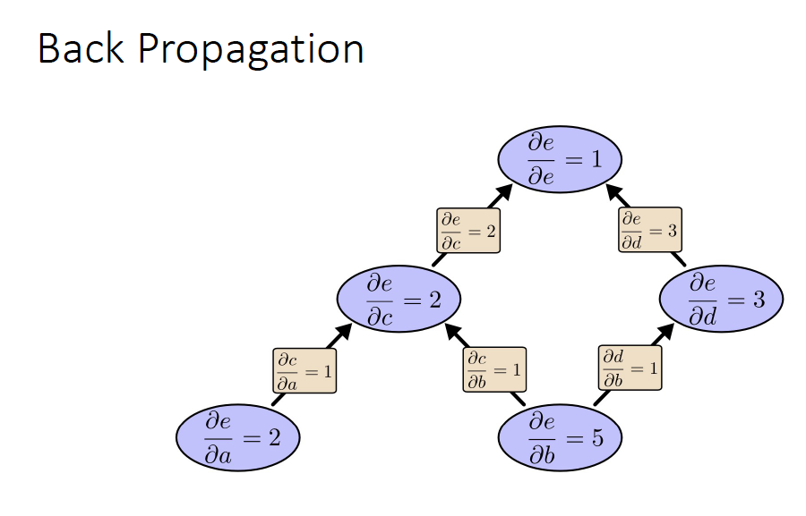

Slide 14
Example

Slide 15
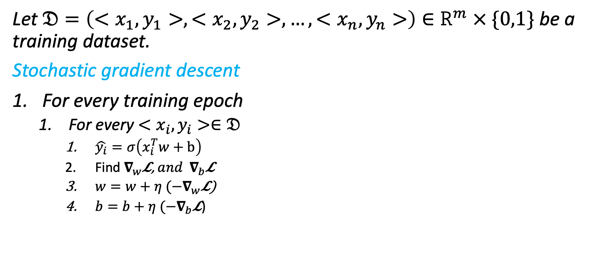
General Learning Rule
Let $𝔇=\left(<x_{1},y_{1}>,<x_{2},y_{2}>,…,<x_{n},y_{n}>\right)∈R^{m} × \{0,1\}$ be a training dataset.
Stochastic gradient descent
For every training epoch
For every $<x_{i},y_{i}>∈𝔇$
$\hat{y_{i}}=σ\left(x_{i}^{T}w+b\right)$
Find $∇_{w}$𝓛, ${and ∇}_{b}$𝓛
$w=w+{η (−∇}_{w}\text{𝓛}\text{)}$
$b=b+{η (−∇}_{b}\text{𝓛}$)

Slide 16
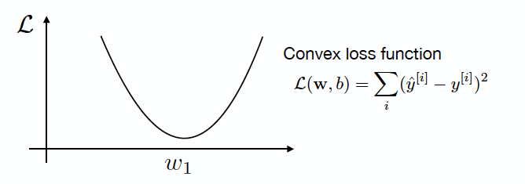
Stochastic Gradient Descent(SGD)
Find the direction where ℒ(w,b) decreases
Slop give the direction in which the loss increases
Move in the direction of negative slope
How much to move? (learning Rate)

Slide 17
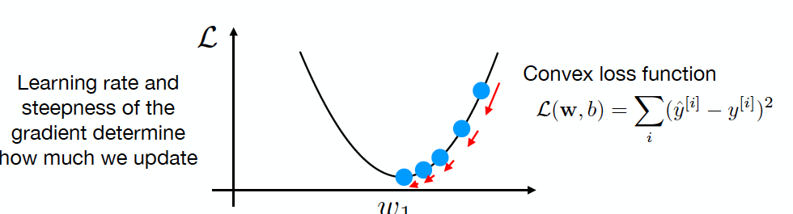
Stochastic Gradient Descent(SGD)
https://sebastianraschka.com/blog/2021/dl-course.html#l01-introduction-to-deep-learning

Slide 18
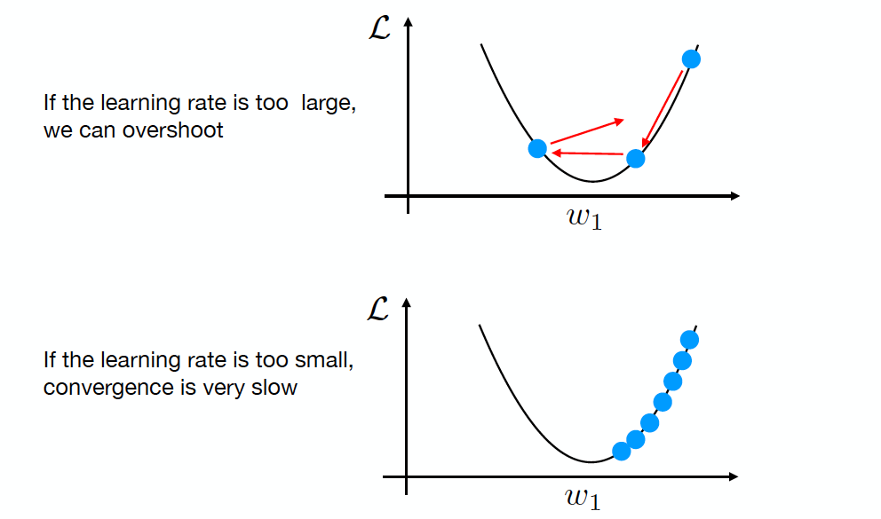
Stochastic Gradient Descent(SGD)
https://sebastianraschka.com/blog/2021/dl-course.html#l01-introduction-to-deep-learning

Slide 19
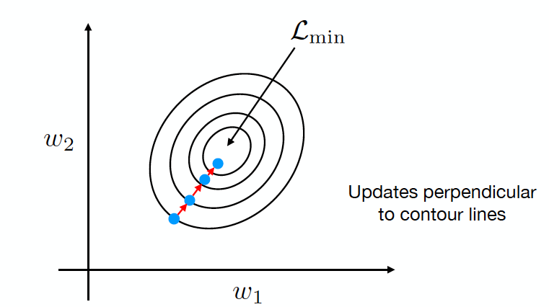
Batch Stochastic Gradient Descent(SGD)
https://sebastianraschka.com/blog/2021/dl-course.html#l01-introduction-to-deep-learning

Slide 20
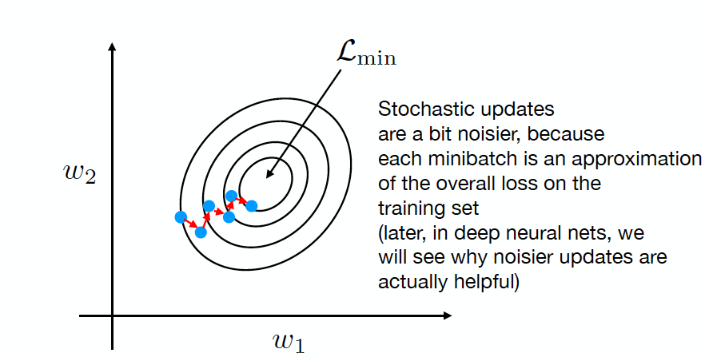
Mini-Batch Stochastic Gradient Descent(SGD)
https://sebastianraschka.com/blog/2021/dl-course.html#l01-introduction-to-deep-learning

Slide 21
Mini Stochastic Gradient Descent(SGD) Parameters at Different Scale
https://sebastianraschka.com/blog/2021/dl-course.html#l01-introduction-to-deep-learning

Slide 22
Logistic Regression

Slide 23

Supervised Machine Learning
$For a given Dataset D=\{\left(x_{1},y_{1}\right)…(x_{n},y_{n})∈R^{m }× R(or C)$
$learn f\left(w,b\right) or f_{w,b} such that f_{w,b}\left(x_{i}\right)≈y_{i}$
Rain classification problem
Model
Output (0 or 1)
Feature Matrix

Slide 24
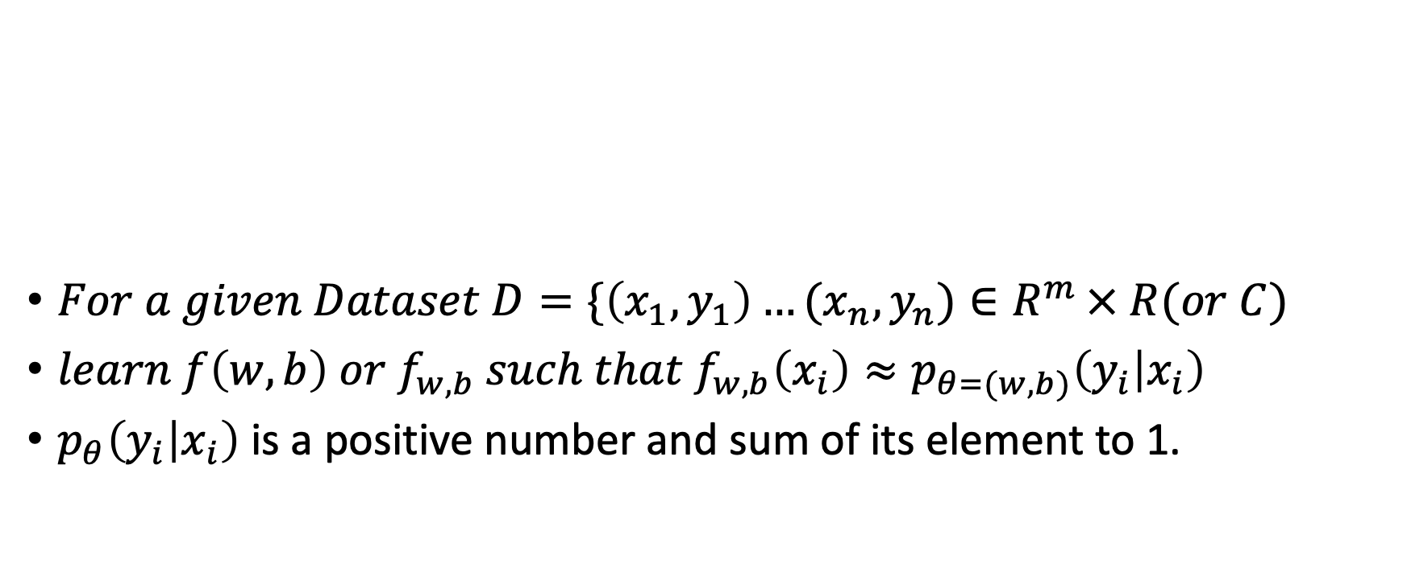
Classification
$For a given Dataset D=\{\left(x_{1},y_{1}\right)…(x_{n},y_{n})∈R^{m }× R(or C)$
$learn f\left(w,b\right) or f_{w,b} such that f_{w,b}\left(x_{i}\right)≈p_{θ=(w,b)}\left(y_{i} | x_{i}\right)$
$p_{θ}\left(y_{i} | x_{i}\right)$ is a positive number and sum of its element to 1.
Model
Rain Prob=90%
Feature Matrix

Slide 25

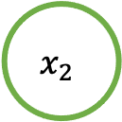

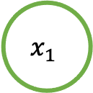

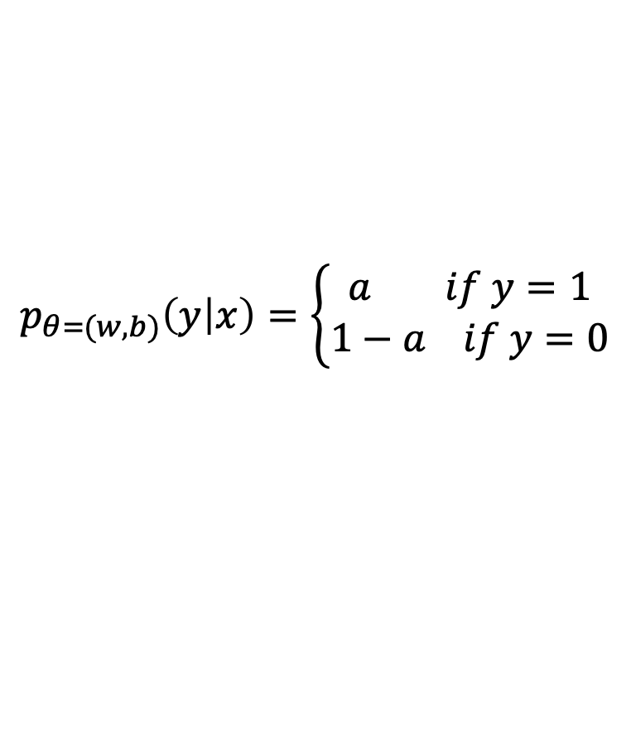

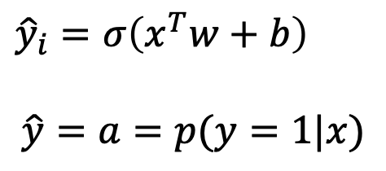
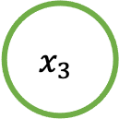

Binary Classification (Logistic Regression)
$$x_{1}$$
$$w_{1}$$
${\hat{y}}_{i}=σ\left(x^{T}w+b\right)$
$$\hat{y}=a=p(y=1|x)$$
$$x_{2}$$
$$w_{2}$$
$$z$$
$${\hat{y}}_{i}=σ\left(x^{T}w+b\right)$$
$$w_{3}$$
$$p_{θ=(w,b)}\left(y | x\right)=\left\{\begin{aligned}a if y=1 \\ 1−a if y=0\end{aligned}\right.$$
$$x_{3}$$

Slide 26

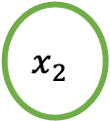

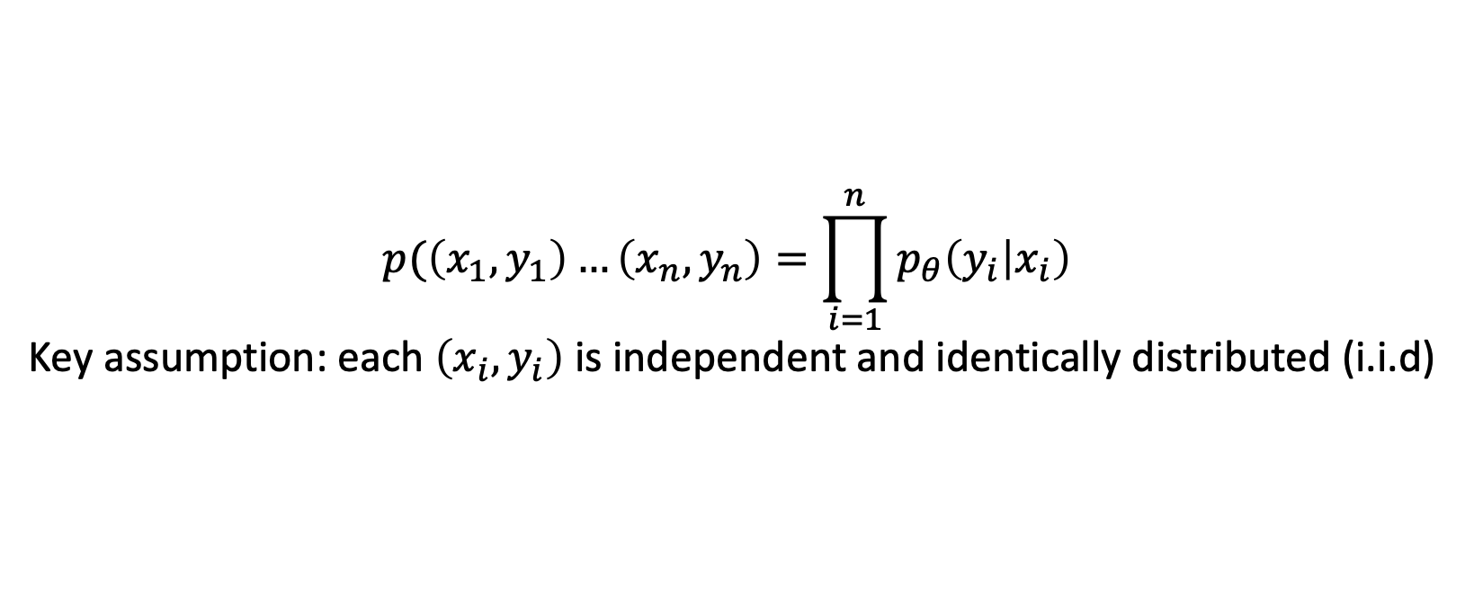
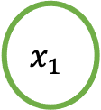

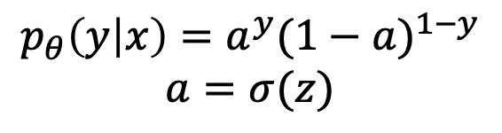

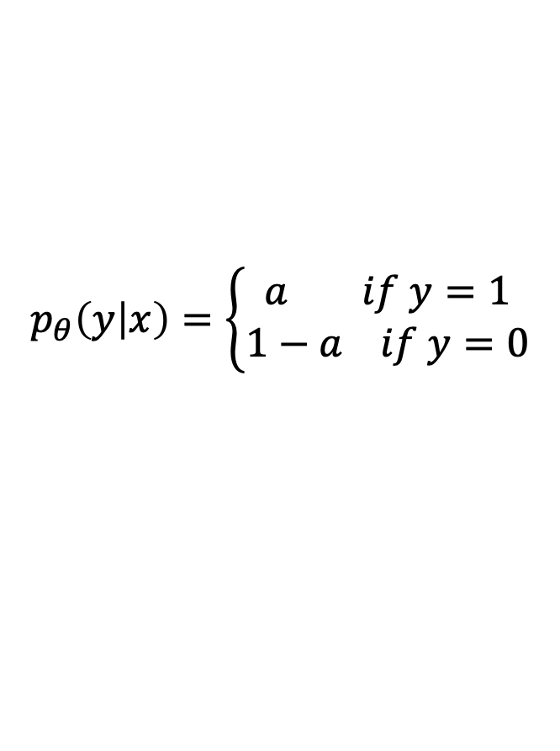
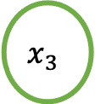

Binary Classification (Logistic Regression)
$$x_{1}$$
$$p_{θ}\left(y | x\right)=\left\{\begin{aligned}a if y=1 \\ 1−a if y=0\end{aligned}\right.$$
$$w_{1}$$
$$p_{θ}\left(y | x\right)=a^{y}{(1−a)}^{1−y}$$
$$a=σ(z)$$
$$x_{2}$$
$$w_{2}$$
$$z$$
$${\hat{y}}_{i}=σ\left(x^{T}w+b\right)$$
$$w_{3}$$
$$x_{3}$$
$$p(\left(x_{1},y_{1}\right)…\left(x_{n},y_{n}\right)=\prod_{i=1}^{n}{p_{θ}\left(y_{i} | x_{i}\right) }$$
Key assumption: each $\left(x_{i},y_{i}\right)$ is independent and identically distributed (i.i.d)

Slide 27
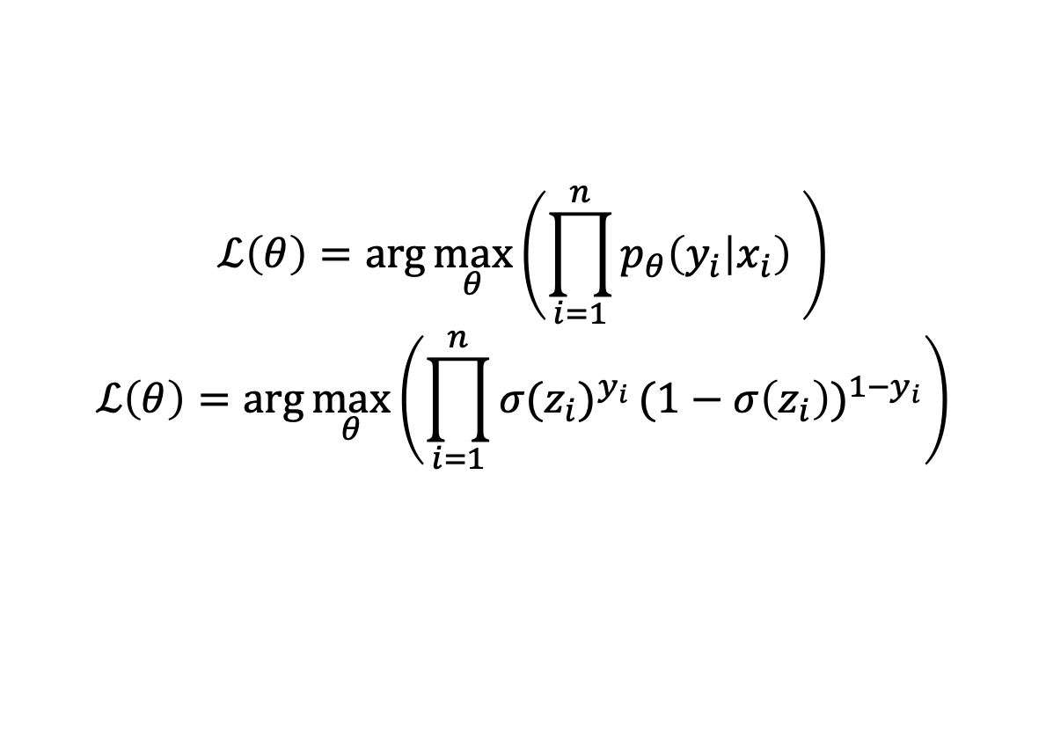
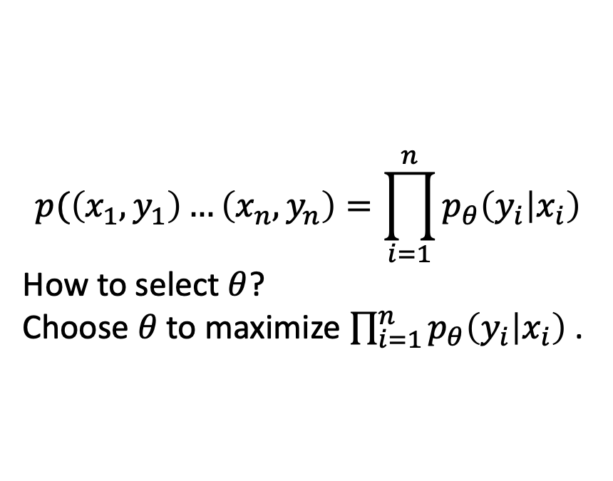
Binary Classification (Logistic Regression)
$$p(\left(x_{1},y_{1}\right)…\left(x_{n},y_{n}\right)=\prod_{i=1}^{n}{p_{θ}\left(y_{i} | x_{i}\right) }$$
How to select $θ$?
Choose $θ$ to maximize $\prod_{i=1}^{n}{p_{θ}\left(y_{i} | x_{i}\right) }$.
$$ℒ\left(θ\right)=\arg{\max_{θ}\left(\prod_{i=1}^{n}{p_{θ}\left(y_{i} | x_{i}\right) }\right)}$$
$$ℒ\left(θ\right)=\arg{\max_{θ}\left(\prod_{i=1}^{n}{{σ(z_{i})}^{y_{i}}}{(1−σ\left(z_{i}\right))}^{{1−y}_{i}}\right)}$$

Slide 28
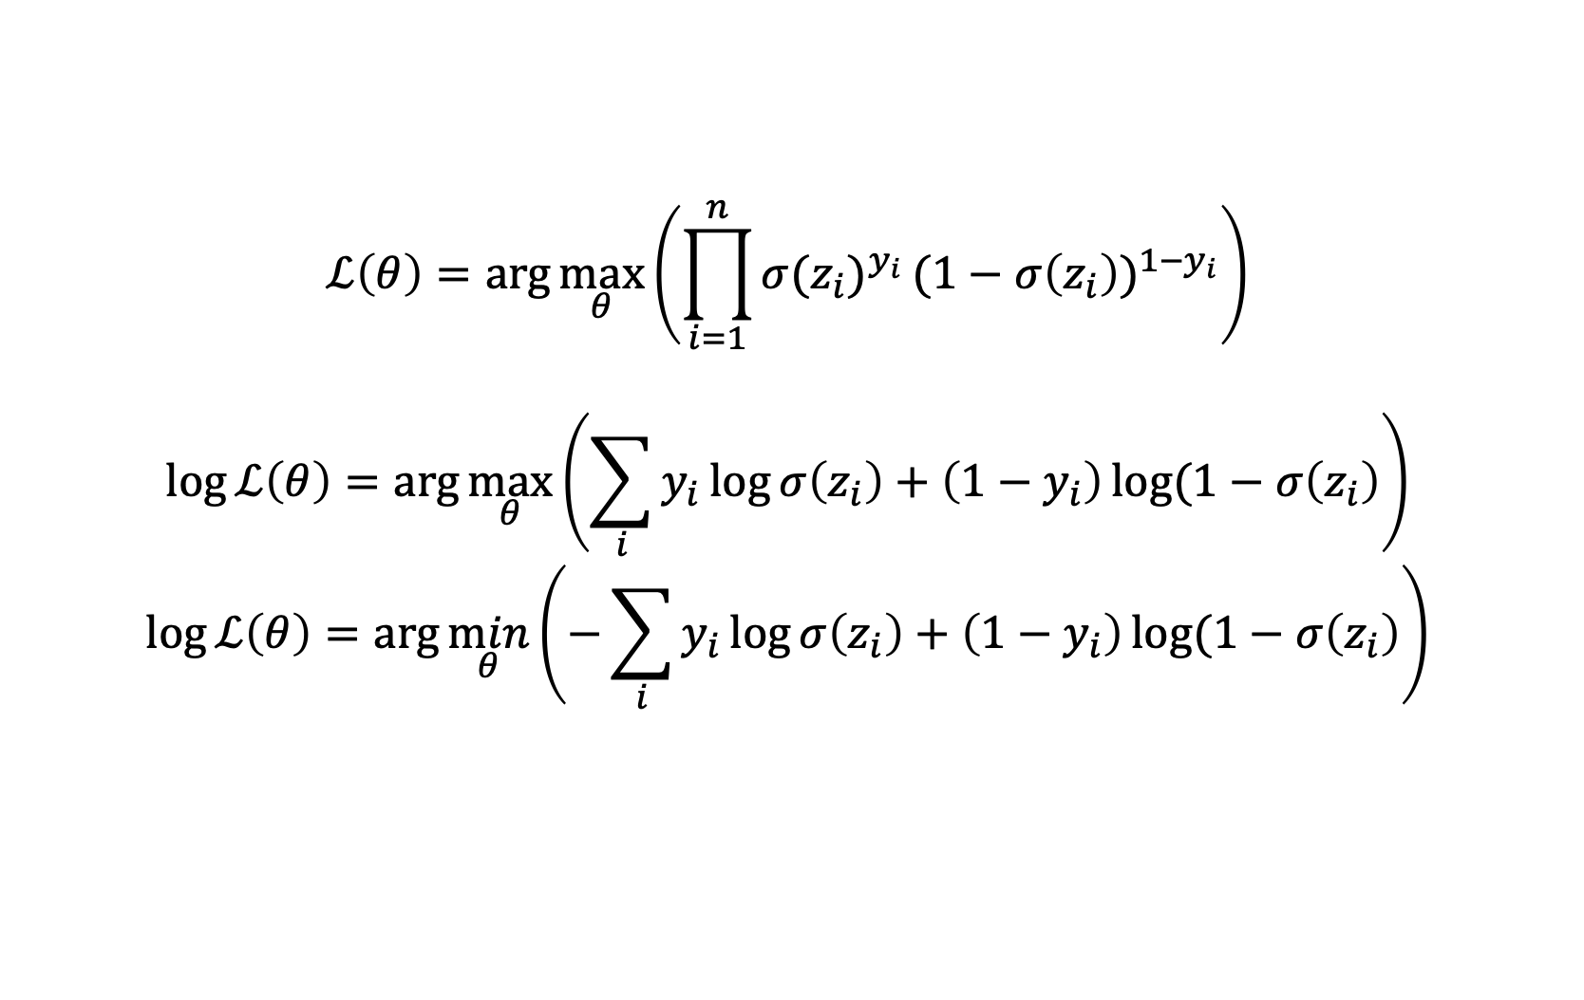
Binary Classification (Logistic Regression)
$$ℒ\left(θ\right)=\arg{\max_{θ}\left(\prod_{i=1}^{n}{{σ(z_{i})}^{y_{i}}}{(1−σ\left(z_{i}\right))}^{{1−y}_{i}}\right)}$$
$$\log{ℒ\left(θ\right)=\arg{\max_{θ}\left(\sum_{i}{y_{i}\log{σ\left(z_{i}\right)+\left(1−y_{i}\right)\log{(1−σ\left(z_{i}\right)}}}\right)}}$$
$$\log{ℒ\left(θ\right)=\arg{\min_{θ}\left(−\sum_{i}{y_{i}\log{σ\left(z_{i}\right)+\left(1−y_{i}\right)\log{(1−σ\left(z_{i}\right)}}}\right)}}$$
Maximum log likelihood
Negative log likelihood
Or
Binary cross Entropy

Slide 29

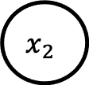

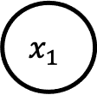



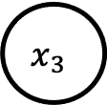

Multinomial Logistic Regression
$$x_{1}$$
$$w_{11}$$
$$z_{1}$$
$${\hat{y}}_{1}=σ({z_{1}) where z_{1}=w}_{11}x_{1}+w_{12}x_{2}+w_{13}x_{3}+b_{1})$$
$$w_{12}$$
$$x_{2}$$
$$z_{2}$$
$${\hat{y}}_{2}=σ({z_{2}) where z_{2}=w}_{21}x_{1}+w_{22}x_{2}+w_{23}x_{3}+b_{2})$$
$$w_{13}$$
$$x_{3}$$
$$z_{3}$$
$${\hat{y}}_{3}=σ({z_{3}) where z_{3}=w}_{31}x_{1}+w_{32}x_{2}+w_{33}x_{3}+b_{3})$$

Slide 30
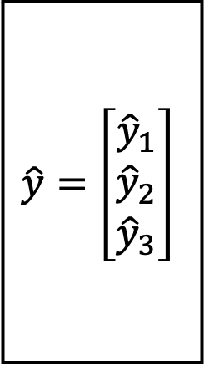
Multinomial Logistic Regression
$$x_{1}$$
$$w_{11}$$
$$z_{1}$$
$$\hat{y}=\left[\begin{matrix}{\hat{y}}_{1} \\ {\hat{y}}_{2} \\ {\hat{y}}_{3}\end{matrix}\right]$$
$$w_{12}$$
$$x_{2}$$
$$z_{2}$$
$$w_{13}$$
$$x_{3}$$
$$z_{3}$$

Slide 31
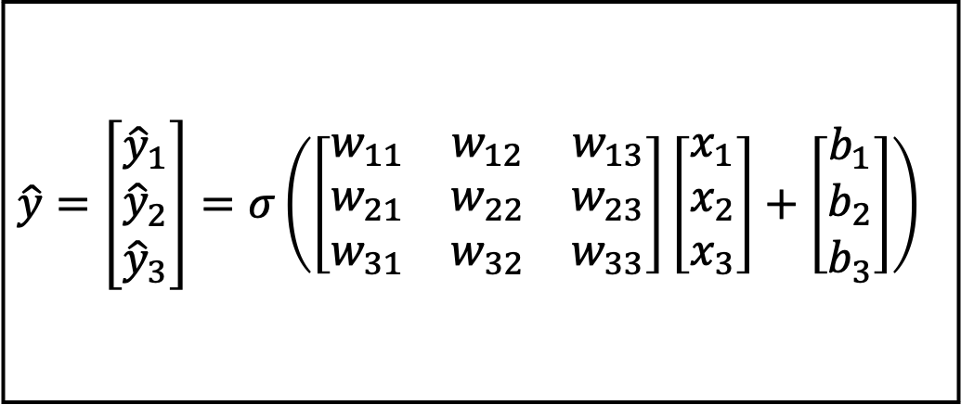
Multinomial Logistic Regression
$$x_{1}$$
$$w_{11}$$
$$z_{1}$$
$$\hat{y}=\left[\begin{matrix}{\hat{y}}_{1} \\ {\hat{y}}_{2} \\ {\hat{y}}_{3}\end{matrix}\right]=σ\left(\left[\begin{matrix}w_{11} & w_{12} & w_{13} \\ w_{21} & w_{22} & w_{23} \\ w_{31} & w_{32} & w_{33}\end{matrix}\right]\left[\begin{matrix}x_{1} \\ x_{2} \\ x_{3}\end{matrix}\right]+\left[\begin{matrix}b_{1} \\ b_{2} \\ b_{3}\end{matrix}\right]\right)$$
$$w_{12}$$
$$x_{2}$$
$$z_{2}$$
$$w_{13}$$
$$x_{3}$$
$$z_{3}$$

Slide 32
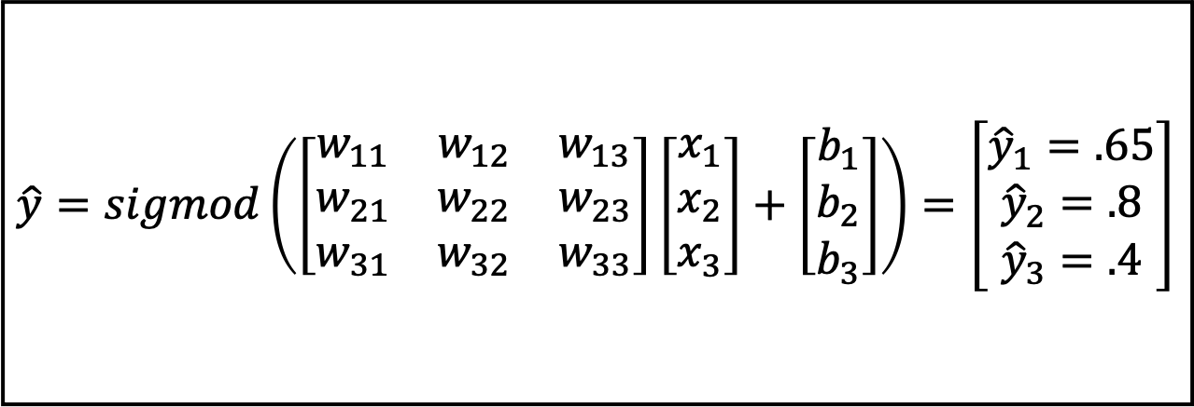
Multinomial Logistic Regression
$$x_{1}$$
$$w_{11}$$
$$\hat{y}=sigmod\left(\left[\begin{matrix}w_{11} & w_{12} & w_{13} \\ w_{21} & w_{22} & w_{23} \\ w_{31} & w_{32} & w_{33}\end{matrix}\right]\left[\begin{matrix}x_{1} \\ x_{2} \\ x_{3}\end{matrix}\right]+\left[\begin{matrix}b_{1} \\ b_{2} \\ b_{3}\end{matrix}\right]\right)=\left[\begin{matrix}{\hat{y}}_{1}=.65 \\ {\hat{y}}_{2}=.8 \\ {\hat{y}}_{3}=.4\end{matrix}\right]$$
$$z_{1}$$
$$w_{12}$$
$$x_{2}$$
$$z_{2}$$
$$w_{13}$$
$$x_{3}$$
$$z_{3}$$
Not a probability distribution. Why?

Slide 33

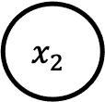

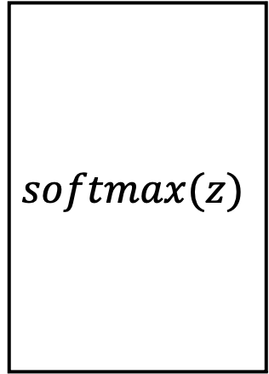
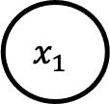

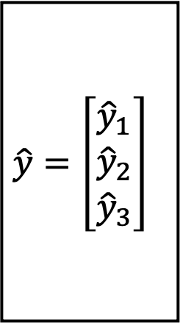


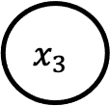

Multinomial Logistic Regression
$$x_{1}$$
$$w_{11}$$
$$z_{1}$$
$$softmax(z)$$
$$\hat{y}=\left[\begin{matrix}{\hat{y}}_{1} \\ {\hat{y}}_{2} \\ {\hat{y}}_{3}\end{matrix}\right]$$
$$w_{12}$$
$$x_{2}$$
$$z_{2}$$
$$w_{13}$$
$$x_{3}$$
$$z_{3}$$

Slide 34

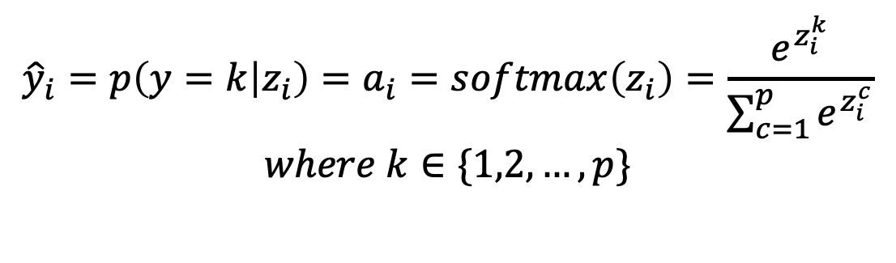
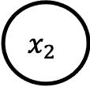

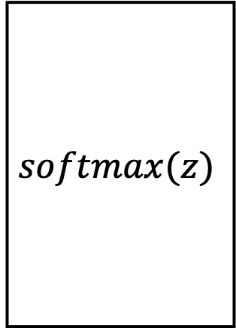
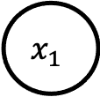

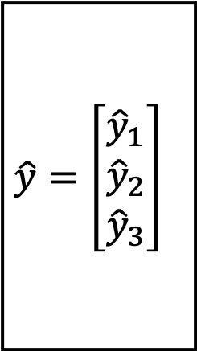



Multinomial Logistic Regression
$$x_{1}$$
$$w_{11}$$
$$z_{1}$$
$$softmax(z)$$
$$\hat{y}=\left[\begin{matrix}{\hat{y}}_{1} \\ {\hat{y}}_{2} \\ {\hat{y}}_{3}\end{matrix}\right]$$
$$w_{12}$$
$$x_{2}$$
$$z_{2}$$
$$w_{13}$$
$$x_{3}$$
$$z_{3}$$
$${\hat{y}}_{i}=p\left(y=k | z_{i}\right)=a_{i}=softmax\left(z_{i}\right)=\frac{e^{z_{i}^{k}}}{\sum_{c=1}^{p}{e^{z_{i}^{c}}}}$$
$$where k∈\{1,2,…,p\}$$

Slide 35



Multinomial Logistic Regression
$p\left(D\right)=\prod_{i=1}^{n}{p(x_{i},y_{i})=}\prod_{i=1}^{n}{p\left(x_{i}\right)p(y_{i}|x_{i})}$
$$\sim p(D)$$
$$D=\{\left(x_{1},y_{1}\right)…(x_{n},y_{n})∈R^{m }× C$$
Key Assumption: Every $\left(x_{i},y_{i}\right) independent and identically distributed$

Slide 36

How to choose distribution parameters?
Choose $θ$ such that $p_{θ}(y|x)≈p(y|x)$
$$p\left(D\right)=\prod_{i=1}^{n}{p\left(x_{i}\right)p\left(y_{i} | x_{i}\right)=\prod_{i=1}^{n}{p\left(x_{i}\right)p_{θ}\left(y_{i} | x_{i}\right)}}$$
$$\log{p\left(D\right)=\sum_{i}{\log{p(x_{i})}}}+\log{p_{θ}(y_{i}|x_{i})}$$
$$\log{p\left(D\right)=}\sum_{i}{\log{p_{θ}\left(y_{i}\right|x_{i}) }}{+ const}$$
$$θ^{’}=\arg{\max_{θ}{(}}\sum_{i}{\log{p_{θ}\left(y_{i}\right|x_{i}) })}$$
$$θ^{’}=\arg{\min_{θ}{(}}−\sum_{i}{\log{p_{θ}\left(y_{i}\right|x_{i}) })}$$
Maximum Likelihood Estimation
Negative Log Likelihood(NLL)

Slide 37

Cross Entropy
$$θ^{’}=\arg{\min_{θ}{(}}−\sum_{i}{\log{p_{θ}\left(y_{i}\right|x_{i}) })}$$
$$θ^{’}=\arg{\min_{θ}\left(−\sum_{i}{\sum_{c}{y_{i}^{k}}log{p_{θ}\left(y_{i}\right|x_{i}) }}\right)}$$
$$θ^{’}=\arg{\min_{θ}\left(−\sum_{i}{\sum_{c}{y_{i}^{k}}log{(a_{i}^{k})}}\right)}$$

Slide 38
Steps in solving a machine learning problem
Define A model
What ?
Define loss function
Why?
Pick optimizer
How?
Train on machine

